Slide 1
CSCCORE1I Software Engineering 1 Web Services, REST and Servlets
Mark Greenwood
email: greenwm1@hope.ac.uk
Zoom: https://hope.zoom.us/j/4155561823
room: FML202

Slide 2
This week ...
Web Services
REST
Servlets and Containers

Slide 3
Web Services

Slide 4
Web Services
A Web service is an application accessible to other applications over the Web.
Defined by W3C as "a software application identified by a URI, whose interfaces and bindings are capable of being defined, described, and discovered as XML artifacts.
A Web service supports direct interactions with other software agents using XML-based messages exchanged via Internet-based protocols“
Web services should be "services“ similar to those in conventional middleware.
They should be described and advertised so that it is possible to write clients that bind and interact with them

Slide 5
Web Service Protocols
Defined by W3C (world wide web consortium)
"a standardized way of integrating Web-based applications using the XML, SOAP, WSDL, and UDDI open standards over an Internet protocol backbone. XML is used to tag the data, SOAP is used to transfer the data, WSDL is used for describing the services available, and UDDI is used for listing what services are available“
SOAP: Simple Object Access Protocol
WSDL: Web Services Description Language
UDDI: Universal Description, Discovery, and Integration

Slide 6
SOAP
The W3C started working on SOAP in 1999. The current W3C recommendation is Version 1.2
SOAP covers the following four main areas:
A message format for one-way communication describing how a message can be packed into an XML document
A description of how a SOAP message (or the XML document that makes up a SOAP message) should be transported using HTTP (for Web based interaction) or SMTP (for e-mail-based interaction)
A set of rules that must be followed when processing a SOAP message. It also specifies what parts of the messages should be read by whom and how to react in case the content is not understood
A set of conventions on how to turn an RPC call into a SOAP message and back as well as how to implement the RPC style of interaction (how the client makes an RPC call, this is translated into a SOAP message, forwarded, turned into an RPC call at the server, the reply of the server converted into a SOAP message, sent to the client, and passed on to the client as the return of the RPC call)

Slide 7
SOAP Messages
SOAP Envelope
SOAP header
A SOAP message is an ordinary XML document containing the following elements:
Envelope − Defines the start and the end of the message. It is a mandatory element.
Header − Contains any optional attributes of the message used in processing the message, either at an intermediary point or at the ultimate end-point. It is an optional element.
Body − Contains the XML data comprising the message being sent. It is a mandatory element.
Fault − An optional Fault element that provides information about errors that occur while processing the message.
SOAP Body
Fault

Slide 8
SOAP Request Example
<?xml version="1.0"?> <soap:Envelope xmlns:soap="http://www.w3.org/2003/05/soap-envelope/" soap:encodingStyle="http://www.w3.org/2003/05/soap-encoding">
<soap:Header> <n:Trans xmlns:n="https://www.w3schools.com/transaction/" soap:mustUnderstand="1">234 </n:Trans> </soap:Header>
<soap:Body xmlns:m="http://www.example.org/stock"> <m:GetStockPrice> <m:StockName>IBM</m:StockName> </m:GetStockPrice> </soap:Body>
</soap:Envelope>

Slide 9
SOAP Response Example
<?xml version="1.0"?> <soap:Envelope xmlns:soap="http://www.w3.org/2003/05/soap-envelope/" soap:encodingStyle="http://www.w3.org/2003/05/soap-encoding"> <soap:Body xmlns:m="http://www.example.org/stock"> <m:GetStockPriceResponse> <m:Price>34.5</m:Price> </m:GetStockPriceResponse> </soap:Body> </soap:Envelope>

Slide 10
WSDL
Web Services Description Language (WSDL) is an XML format for describing all the information needed to invoke and communicate with a Web Service.
A WSDL Document is a set of definitions with a single root element. Services can be defined using the following XML elements

Slide 11
When to use Web Services
While web services are appropriate in many scenarios, they shouldn’t be used in every situation.
Web services are “expensive” to call and have the risk of failure (either client, service, or network itself fails)
Use Web Services when..
The client and service belong to different application domains and the “service functions” cannot be easily imported into the client.
The client is a complex business process that incorporates functions from multiple application domains. The logical services are owned and managed by different organizations and change at different rates.
The divide between the client and server is natural. The client may, for example, be a mobile or desktop application that uses common business functions.

Slide 12
REST

Slide 13
Representational State Transfer
Stands for “Representational State Transfer“
REST, unlike SOAP, is not a web service standard protocol but an architectural style for web applications.
REST was devised by Roy Fielding in his doctoral dissertation
"Representation State Transfer is intended to evoke an image of how a well-designed Web application behaves: a network of web pages where the user progresses through an application by selecting links (state transitions), resulting in the next page (representing the next state of the application) being transferred to the user and rendered for their use."

Slide 14
Representational State Transfer
The previous definition focuses on the rationale behind the design of modern web architecture styles:
REST is a client-server architecture
Only representations of resources are exposed to the client
The representation of resources places the client application in a state.
Client state may evolve by traversing hyperlinks and obtaining new representations

Slide 15
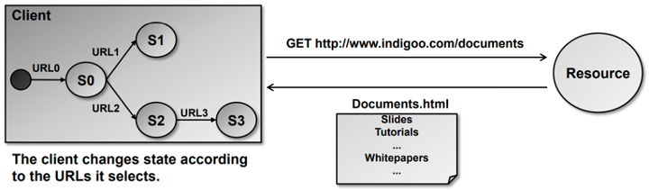
Representational State Transfer
The client references a web resource using a URL.
The web server returns a representation of the resource as an HTML document.
This resource places the client into a new state.
The user clicks on a link in the resource (e.g., Documents.html) which results in another resource access.
The new resource places the client in a new state.
The client application changes (=transfers) state with each resource representation.

Slide 16
Representational State transfer
REST makes use of existing web standards (HTTP, URL, XML, JSON, MIME types).
REST is resource oriented. Resources (pieces of information) are addressed by URIs and passed from server to client (or the other way round).
Every resource is uniquely addressable using hyperlinks.
All resources share a uniform interface for the transfer of state between client and resource, consisting of:
a limited set of well-defined operations (GET, PUT, POST, DELETE).
a limited set of content types (text/html, text/xml etc.).

Slide 17
REST Architectural Constraints
REST defines 6 architectural constraints that a system architecture should comply with to obtain scalability.
Client-server paradigm
A client retrieves resources from a server or updates resources on a server.
Separation of concerns such as presentation (client) from data storage (server).
Portability (UI may be ported to different platforms).

Slide 18
REST Architectural Constraints
Stateless
A client request contains all information necessary for the server to understand the request. No need for storing context (state) on the server.
Cacheable
Data (resources) need to be labeled as cacheable or non-cacheable. This aims to improve network performance.
Uniform interface
Uniform interface means that resources are identified in a standard way. Resources are manipulated with standard methods. This enables simplified architecture and decoupling of application (service) from interface.

Slide 19
REST Architectural Constraints
Layered system
A client cannot ordinarily tell whether it is connected directly to the end server, or to an intermediary along the way.
Intermediary servers may improve system scalability by enabling load-balancing and by providing shared caches.
Layers may also enforce security policies.
Code on demand
This condition allows the customer to run some code on demand, that is, extend part of server logic to the client, either through scripts or code.
Thus, different customers may behave in specific ways even using exactly the same services provided by the server. It can be used when performing some of the client-side services which are more efficient or faster.

Slide 20
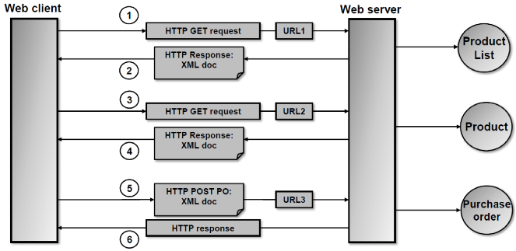
REST Example

Slide 21
T
1. & 2. product list request:
The client requests a product list that is available under the URL http://www.cool-products.com/products&flavor=xml (URL1). The response contains the resource encoded in XML or JSON.
3. & 4. product selection:
The client application (or the user in front of the browser) selects product 00345 by placing a request for the URL http://www.cool-products.com/products/00345&flavor=xml (URL2). The response contains an XML, or JSON, representation of the product info for product 00345.
5. & 6. placing a purchase order:
The client application places a purchase order (PO) for product 00345 by requesting the resource under the URL http://www.cool-products.com/products/00345/PO?quantity=7 (URL3). The purchase order contains additional information entered on the client (customer name etc.). Therefore, the request is a POST accompanied by the XML, or JSON, representation of the purchase order.

Slide 22
Servlets

Slide 23
Servlets
Servlet technology is primarily designed for use with the HTTP protocol of the Web.
Servlets are Java programs that run on a Web server. Java servlets can be used to process client requests or produce dynamic Web pages.

Slide 24
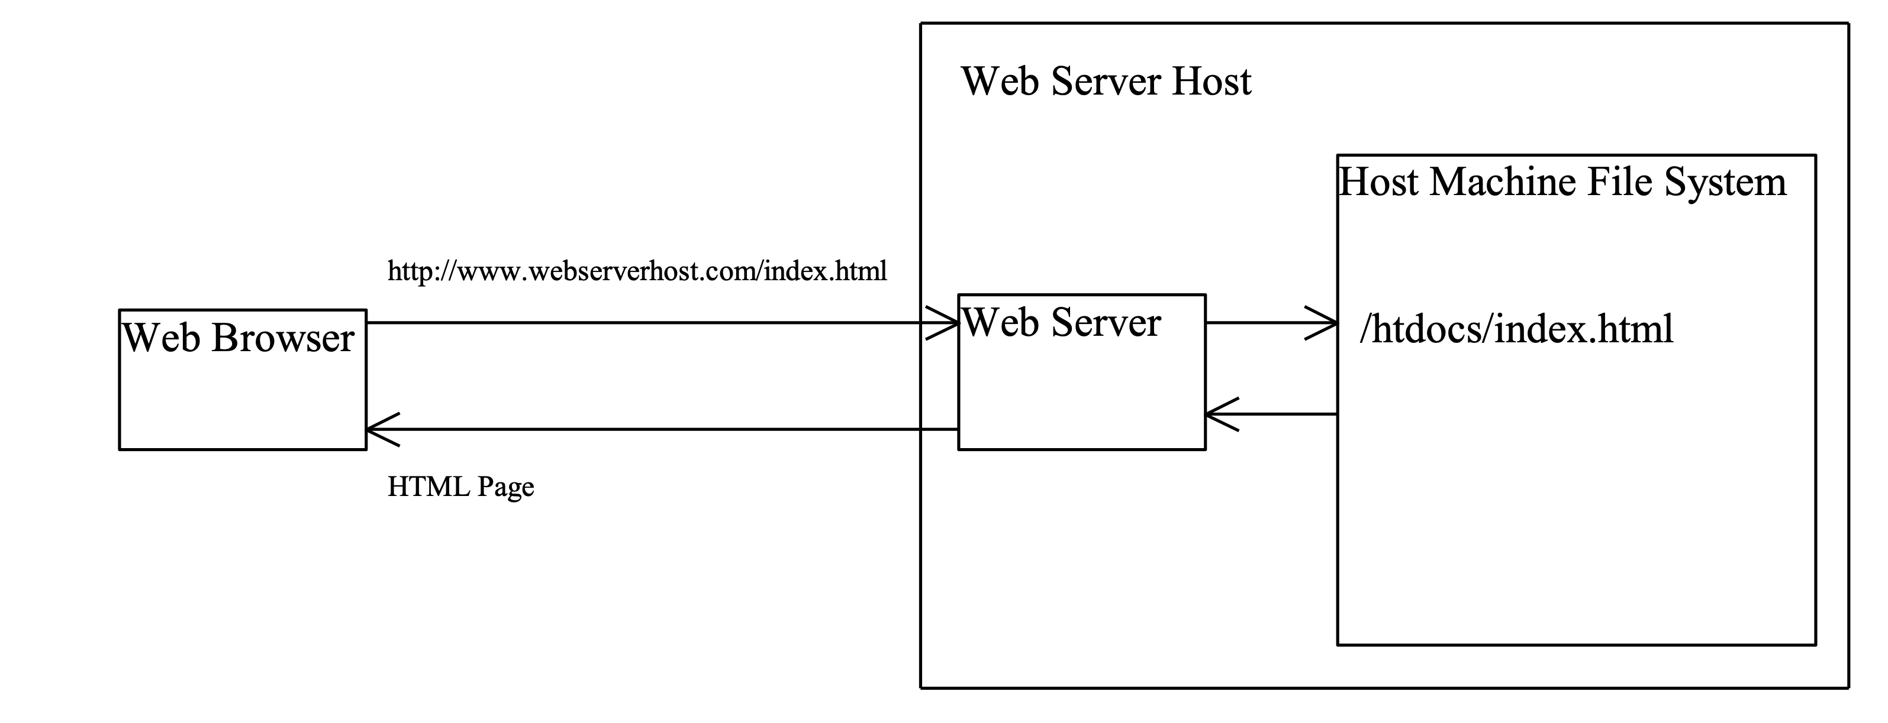
HTTP and HTML

Slide 25
CGI
The Common Gateway Interface, or CGI, was proposed to generate dynamic Web contents.
The interface provides a standard framework for Web servers to interact with external programs, known as the CGI programs.

Slide 26
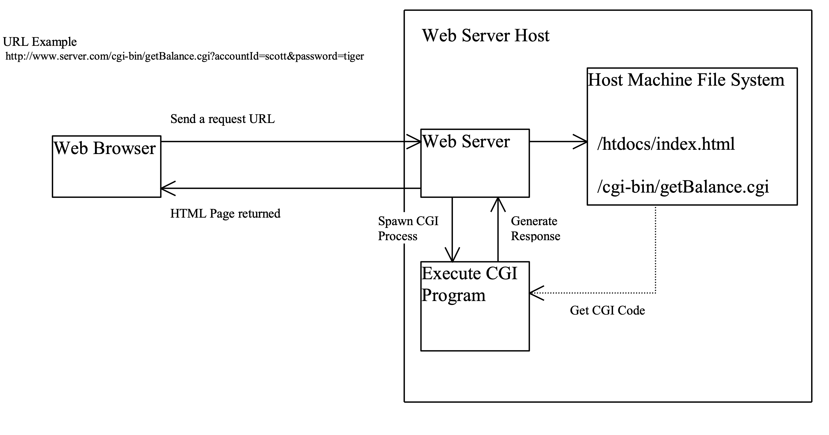
CGI

Slide 27
Get and POST
The two most common HTTP requests, also known as methods, are GET and POST.
The Web browser issues a request using a URL or an HTML form to trigger the Web server to execute a CGI program.
When issuing a CGI request directly from a URL, the GET method is used. This URL is known as a query string.

Slide 28
CGI Query String
The URL query string consists of the location of the CGI program, parameters and their values.
http://www.webserverhost.com/cgi-bin/ getBalance.cgi?accountId=scott+smith&password=tiger
The ? symbol separates the program from the parameters. The parameter name and value are associated using the = symbol. The parameter pairs are separated using the & symbol. The + symbol denotes a space character.

Slide 29
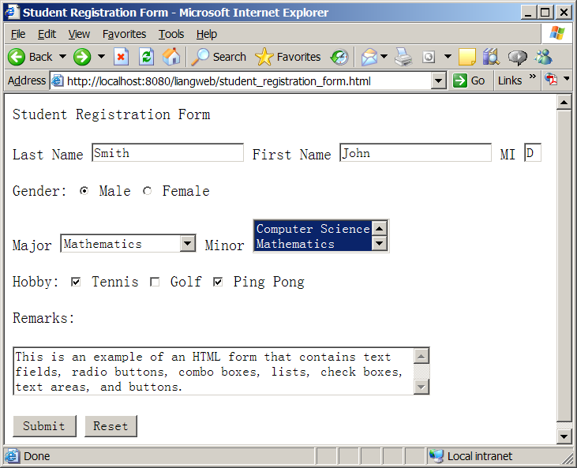
HTML Forms
HTML forms enable you to submit data to the Web server in a convenient form.
The form can contain text fields, text area, check boxes, combo boxes, lists, radio buttons, and buttons.

Slide 30
CGI to Java Servlets
Java servlets are Java programs.
They function like CGI programs.
They are executed upon the request from Web browser.
All the servlets run inside a servlet container. A servlet container is also referred to as a servlet server, or a servlet engine.
A servlet container is a single process that runs a JVM.
The JVM creates a thread to handle each servlet. Java threads have much less overhead than full-brown processes.
All the threads share the same memory allocated to the JVM.

Slide 31
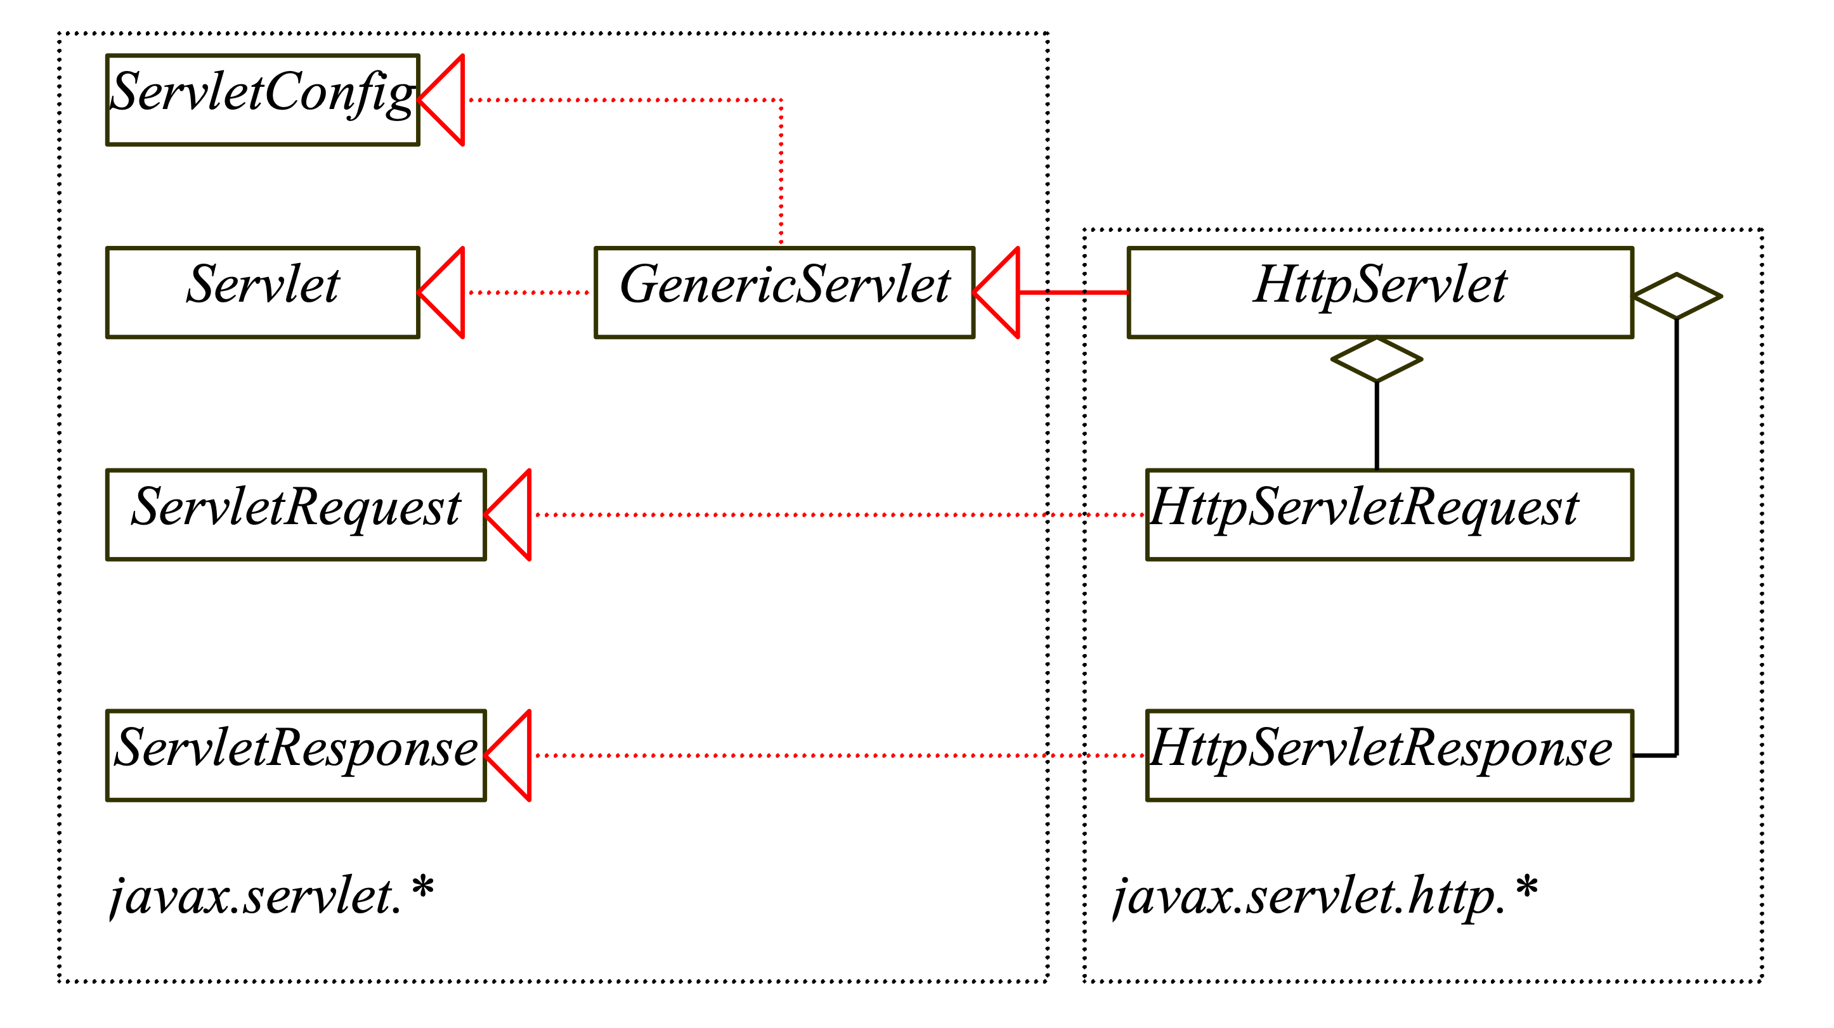
The Servlet API
The servlet API provides the interfaces and classes that support servlets. These interfaces and classes are grouped into two packages: javax.servlet, and javax.servlet.http.

Slide 32
The Servlet Interface
/**Invoked for every servlet constructed*/
public void init(ServletConfig p0) throws ServletException;
/**Invoked to respond to incoming requests*/
public void service(ServletRequest p0, ServletResponse p1)
throws ServletException, IOException;
/**Invoked to release resource by the servlet*/
public void destroy();
/**Return information about the servlet*/
public String getServletInfo();
/**Return configuration objects of the servlet*/
public ServletConfig getServletConfig();

Slide 33
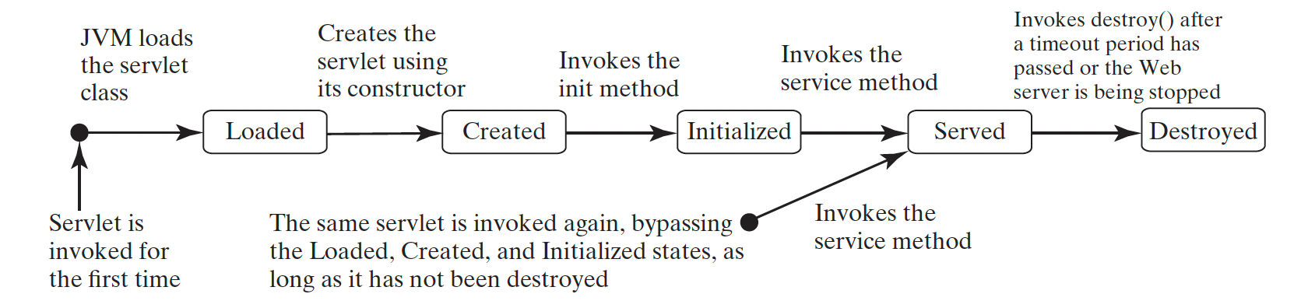
The Servlet Life-Cycle

Slide 34
The Servlet Life-Cycle
The init method is called when the servlet is first created and is not called again as long as the servlet is not destroyed. This resembles the applet’s init method, which is invoked when the applet is created, and is not invoked again as long as applet is not destroyed.
The service method is invoked each time the server receives a request for the servlet. The server spawns a new thread and invokes service.
The destroy method is invoked once all threads within the servlet's service method have exited or after a timeout period has passed. This method releases resources for the servlet.

Slide 35
The HTTPServlet class
The HttpServlet class defines a servlet for the HTTP protocol.
It extends GenericServlet and implements the service method.
The service method is implemented as a dispatcher of HTTP requests.
The HTTP requests are processed in the following methods: doGet, doPost, doDelete, doPut, doOptions, and doTrace. All these methods have the same signature as follows:
protected void doXxx(HttpServletRequest req, HttpServletResponse resp) throws ServletException, java.io.IOException

Slide 36
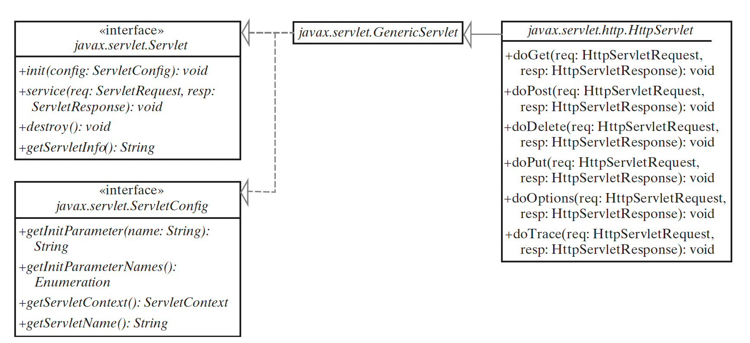
The HTTPServlet class

Slide 37
The HTTPServletRequest interface
Every doXxx method in the HttpServlet class has an argument of the HttpServletRequest type, which is an object that contains HTTP request information including parameter name and values, attributes, and an input stream.
HttpServletRequest is a sub-interface of ServeletRequest. ServletRequest defines a more general interface to provide information for all kinds of clients.

Slide 38
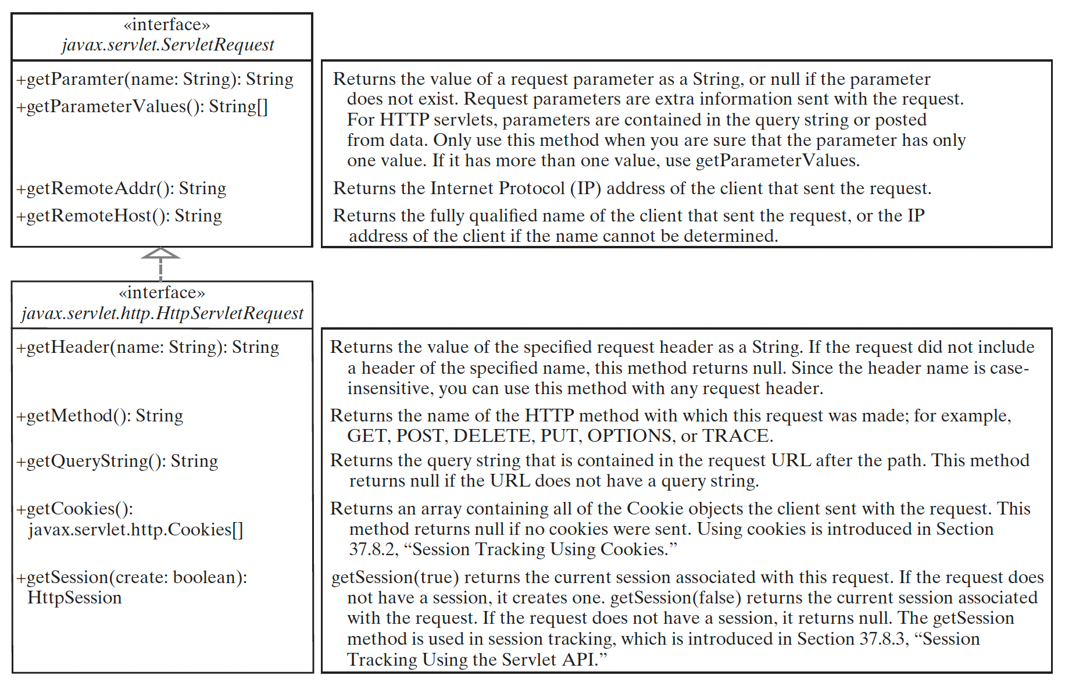
The HTTPServletRequest interface

Slide 39
The HTTPServletResponse Interface
Every doXxx method in the HttpServlet class has an argument of the HttpServletResponse type, which is an object that assists a servlet in sending a response to the client.
HttpServletResponse is a sub-interface of ServeletResponse. ServletRequest defines a more general interface for sending output to the client.

Slide 40
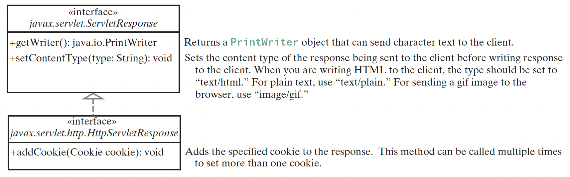
The HTTPServletResponse Interface

Slide 41
Creating Servlets
To write a Java servlet, you define a class that extends the HttpServlet class.
A servlet engine (e.g., Tomcat) controls the servlets using the init, doGet, doPost, destroy, and other methods.
By default, the doGet and doPost methods do nothing.
To handle the GET request, you need to override the doGet method.
To handle the POST request, you need to override the doPost method.

Slide 42
Dynamic Programming using Servlets
Many dynamic Web applications use databases to store and manage data.
Servlets can connect to any relational database via JDBC (Java Database Connectivity).
Connecting a servlet to a database is no different from connecting a Java application to a database.
If you know Java servlets and JDBC, you can combine them together to develop web-based interactive applications or services relatively easily.
BUT – its easier using Spring!

Slide 43
Sessions
Web servers use Hyper-Text Transport Protocol (HTTP).
HTTP is a stateless protocol. The HTTP Web server cannot associate requests from a client together.
Each request is treated independently by the Web server. This protocol works fine for simple Web browsing, where each request typically results in an HTML file, or a text file being sent back to the client. Such simple requests are isolated.
However, the requests in interactive web applications or services are often related.

Slide 44
Sessions
A session can be defined as a series of related interactions between a single client and the Web server over a period of time.
To track data among requests in a session is known as session tracking
Techniques:
Hidden values
Cookies
Servlet API session tracking tools

Slide 45
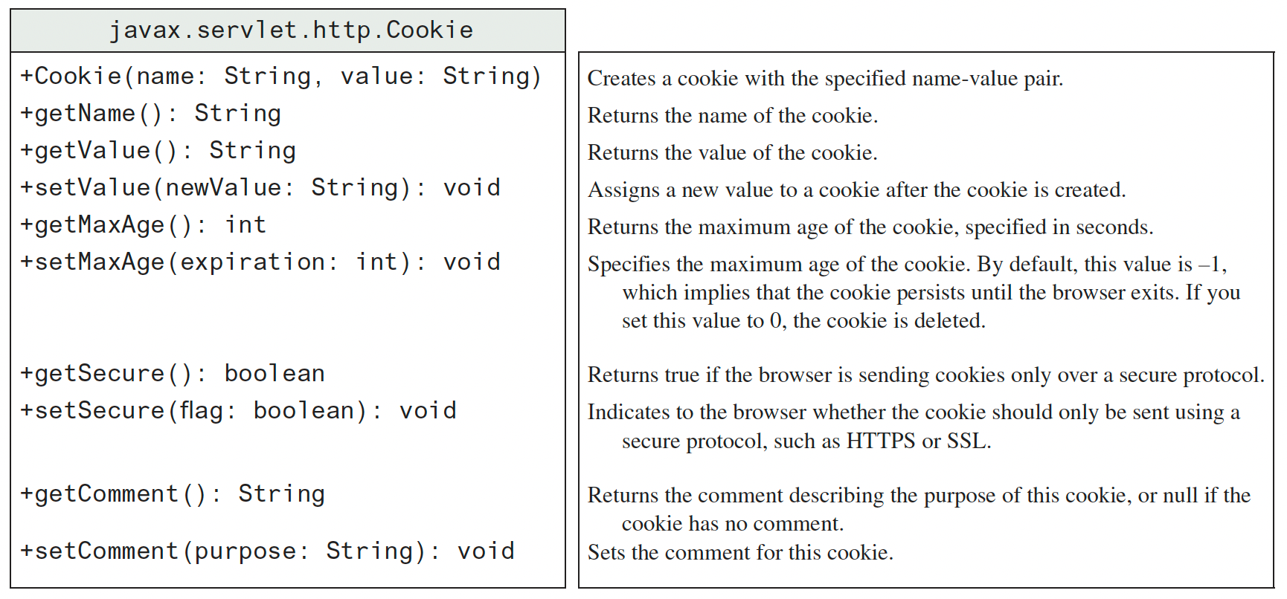
Session Tracking: Cookies

Slide 46
Session Tracking: Cookies
To send a cookie to a browser use the addCookie() function in HttpServletResponse
To obtain cookies from a server use the getCookies() function in HttpServletRequest

Slide 47
The HTTPSession class
The problems of session tracking with hidden data and cookies are that data are not secured andit is difficult to deal with large set of data.
Java servlet API provides a session tracking tool, which enables tracking of a large set of data.
Data can be stored as objects. Data are kept on the server-side, so they are secure.

Slide 48
The HTTPSession class
To use the Java servlet API for session tracking, first create a session object using the getSession method in the HttpServletRequest interface like this:
HttpSession session = request.getSession(true);
This obtains the session or creates a new session if the client does not have a session on the server.
The HttpSession class provides the methods for reading and storing data to the session, and for manipulating the session.

Slide 49
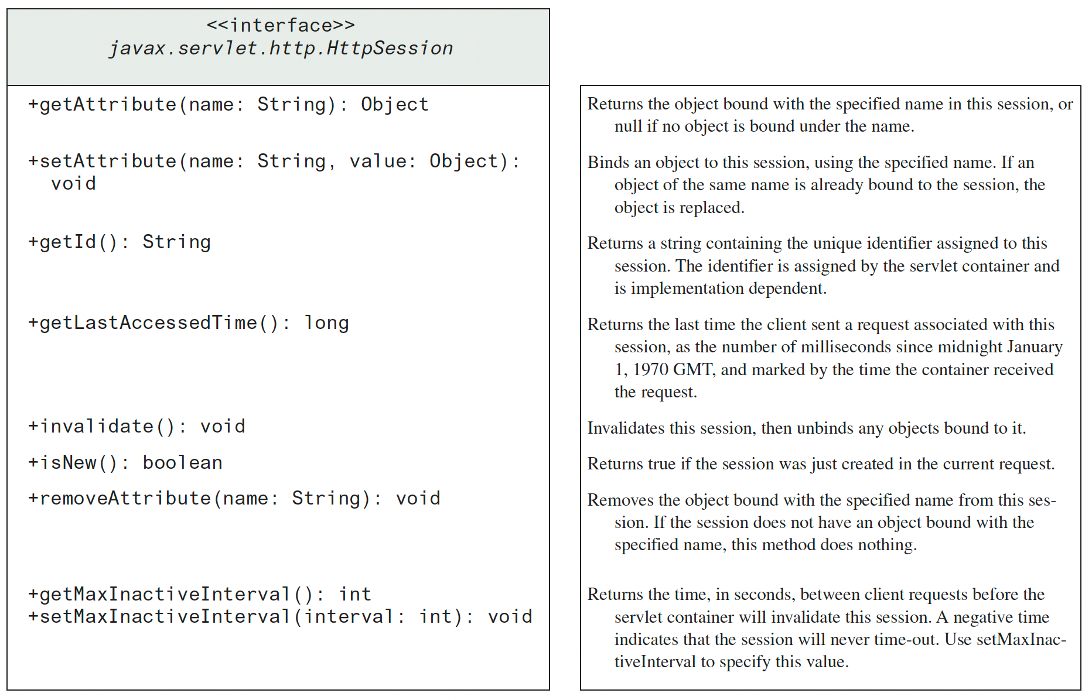
The HTTPSession class

Slide 50
Next time ...
Introducing SpringBoot and JDBC

